Slide 1
Introduction to DBMS

Slide 2
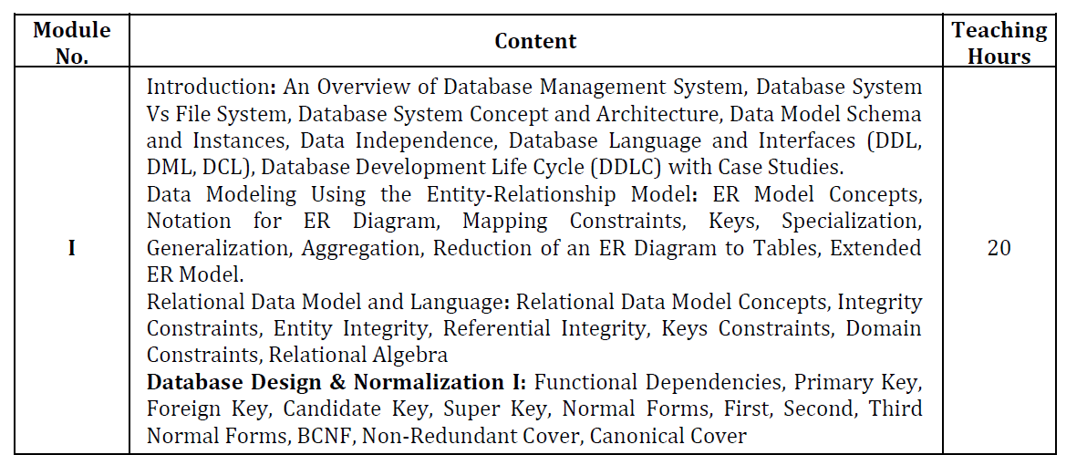
Course Overview

Slide 3
Course Overview

Slide 4
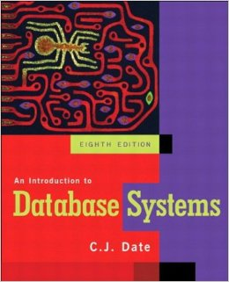
Literature

Slide 5
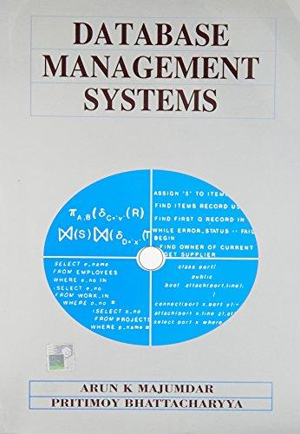
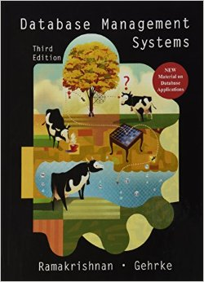
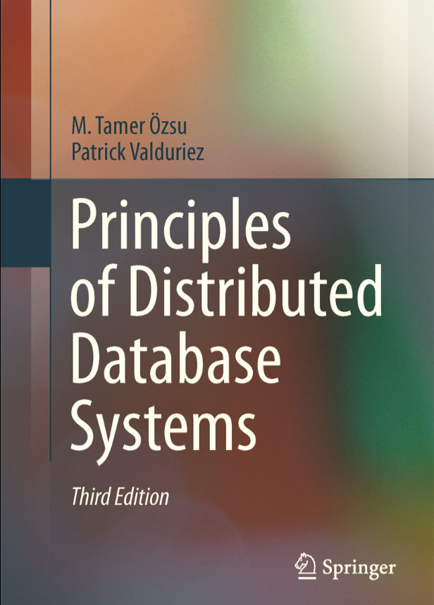
Literature

Slide 6
Data, Database, DBMS
Data: Known facts that can be recorded and have an implicit meaning; raw
Database: A highly organized, interrelated, and structured set of data about a particular enterprise
Controlled by a database management system (DBMS)
DBMS:
A collection of programs that enables users to create and maintain a database
Set of programs to access the data
An environment that is both convenient and efficient to use
A software package/system to facilitate the creation and maintenance of a computerized database
Database System:
The DBMS software together with the data itself. Sometimes, the applications are also included.

Slide 7
Mini-world:
Some part of the real world about which data is stored in a database. For example, student grades and transcripts at a university.
A database is designed, built, and populated with data for a specific purpose.
Database systems are used to manage collections of data that are:
Highly valuable
Relatively large
Accessed by multiple users and applications, often at the same time.
A modern database system is a complex software system whose task is to manage a large, complex collection of data.

Slide 8
Types of Databases and Database Applications
Traditional applications:
Numeric and textual databases
More recent applications:
Multimedia databases
Geographic Information Systems (GIS)
Biological and genome databases
Data warehouses
Mobile databases
Real-time and active databases

Slide 9
Recent Developments
Social Networks started capturing a lot of information about people and about communications among people-posts, tweets, photos, videos in systems such as:
- Facebook
- Twitter
- Linked-In
All of the above constitutes data
Search Engines, Google, Bing, Yahoo: collect their own repository of web pages for searching purposes
New technologies are emerging from the so-called non-SQL, non-database software vendors to manage vast amounts of data generated on the web:
Big data storage systems involving large clusters of distributed computers
NOSQL (Non-SQL, Not Only SQL) systems
A large amount of data now resides on the “cloud” which means it is in huge data centers using thousands of machines.

Slide 10
What a DBMS Facilitates
DBMS is a general-purpose software system that facilitates the processes of defining, constructing, manipulating, and sharing databases among various users and applications.
Define a particular database in terms of its data types, structures, and constraints
Construct or load the initial database contents on a secondary storage medium
Manipulating the database:
Retrieval: Querying, generating reports
Modification: Insertions, deletions and updates to its content
Accessing the database through Web applications (e.g., GLA Module)
Processing and sharing by a set of concurrent users and application programs – yet, keeping all data valid and consistent

Slide 11
Other DBMS Functionalities
DBMS may additionally provide:
Protection or security measures to prevent unauthorized access
Presentation and visualization of data
Maintenance of the database and associated programs over the lifetime of the database application

Slide 12
Application Programs and DBMS
Applications interact with a database by generating
Queries: that access different parts of data and formulate the result of a request
Transactions: that may read some data and “update” certain values or generate new data and store that in the database

Slide 13
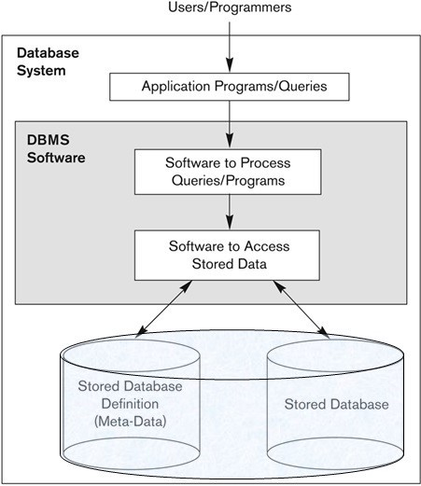
Simplified database system environment

Slide 14
Example of a Database
Mini-world for the example:
Part of a UNIVERSITY environment
Some mini-world entities:
STUDENTs
COURSEs
SECTIONs (of COURSEs)
(Academic) DEPARTMENTs
INSTRUCTORs

Slide 15
Example of a Database
Some mini-world relationships:
SECTIONs are of specific COURSEs
STUDENTs take SECTIONs
COURSEs have prerequisite COURSEs
INSTRUCTORs teach SECTIONs
COURSEs are offered by DEPARTMENTs
STUDENTs major in DEPARTMENTs
The above entities and relationships are typically expressed in a conceptual data model, such as the entity-relationship (ER) data or UML class model.

Slide 16
Example of a Database

Slide 17
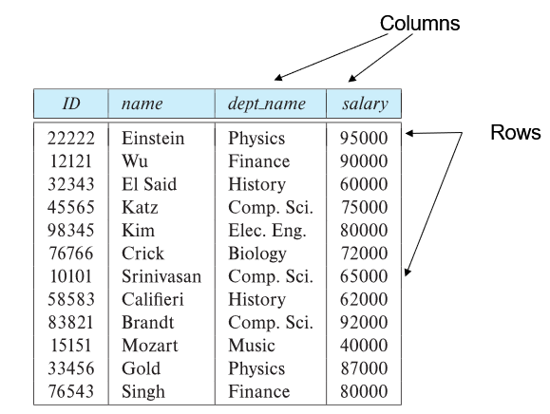
The relational model

Slide 18
Main Characteristics of the Database Approach
A number of characteristics distinguish the database approach from the much older approach of programming with files. In traditional file processing, each user defines and implements the files needed for a specific software application as part of programming the application. For example, one user, the grade reporting office, may keep files on students and their grades. Programs to print a student’s transcript and to enter new grades are implemented as part of the application. A second user, the accounting office, may keep track of students’ fees and their payments. Although both users are interested in data about students, each user maintains separate files—and programs to manipulate these files—because each requires some data not available from the other user’s files. This redundancy in defining and storing data results in wasted storage space and in redundant efforts to maintain common up-to-date data.
In the database approach, a single repository maintains data that is defined once and then accessed by various users. In file systems, each application is free to name data elements independently. In contrast, in a database, the names or labels of data are defined once, and used repeatedly by queries, transactions, and applications.

Slide 19
Main Characteristics of the Database Approach
The main characteristics of the database approach versus the file-processing approach are the following:
Self-describing nature of a database system
Insulation between programs and data, and data abstraction
Support of multiple views of the data
Sharing of data and multiuser transaction processing

Slide 20
Main Characteristics of the Database Approach
Self-describing nature of a database system
Database system contains not only the database itself but also a complete definition or description of the database structure and constraints.
This definition is stored in the DBMS catalog, which contains information such as the structure of each file, the type and storage format of each data item, and various constraints on the data.
A DBMS catalog stores the description of a particular database (e.g. data structures, types, and constraints).
The description is called meta-data.
This allows the DBMS software to work with different database applications.
In traditional file processing, data definition is typically part of the application programs themselves. Hence, these programs are constrained to work with only one specific database, whose structure is declared in the application programs. For example, an application program written in C++ may have struct or class declarations. Whereas file-processing software can access only specific databases, DBMS software can access diverse databases by extracting the database definitions from the catalog and using these definitions.

Slide 21
Example of a simplified database catalog

Slide 22
Main Characteristics of the Database Approach (continued)
Insulation between programs and data
In traditional file processing, the structure of data files is embedded in the application programs, so any changes to the structure of a file may require changing all programs that access that file.
By contrast, DBMS access programs do not require such changes in most cases. The structure of data files is stored in the DBMS catalog separately from the access programs.
This property is called program-data independence.
Allows changing data structures and storage organization without having to change the DBMS access programs.

Slide 23
Main Characteristics of the Database Approach (continued)
For example, a file access program may be written in such a way that it can access only STUDENT records of the structure as shown below:
If we want to add another piece of data to each STUDENT record, say the Birth_date, such a program will no longer work and must be changed. By contrast, in a DBMS environment, we only need to change the description of STUDENT records in the catalog to reflect the inclusion of the new data item Birth_date; no programs are changed. The next time a DBMS program refers to the catalog, the new structure of STUDENT records will be accessed and used.

Slide 24
Main Characteristics of the Database Approach (continued)
Data Abstraction
The characteristic that allows program-data independence is called data abstraction.
A DBMS provides users with a conceptual representation of data that does not include many of the details of how the data is stored or how the operations are implemented.
A data model is a type of data abstraction that is used to provide this conceptual representation.
Data model hides storage and implementation details that are not of interest to most database users.
A data model is used to hide storage details and present the users with a conceptual view of the database.
The data model uses logical concepts, such as objects, their properties, and their interrelationships, that may be easier for most users to understand than computer storage concepts.
Programs refer to the data model constructs rather than data storage details.

Slide 25
Main Characteristics of the Database Approach (continued)
Support of multiple views of the data
A database typically has many users, each of whom may require a different perspective or view of the database.
A view may be a subset of the database or it may contain virtual data that is derived from the database files but is not explicitly stored.
Each user may see a different view of the database, which describes only the data of interest to that user.

Slide 26
Main Characteristics of the Database Approach (continued)
Sharing of data and multi-user transaction processing
Allowing a set of concurrent users to retrieve from and to update the database.
A multiuser DBMS must allow multiple users to access the database at the same time.
DBMS must include concurrency control software to ensure that several users trying to update the same data do so in a controlled manner so that the result of the updates is correct.
Concurrency control within the DBMS guarantees that each transaction is correctly executed or aborted.
For example, when several reservation agents try to assign a seat on an airline flight, the DBMS should ensure that each seat can be accessed by only one agent at a time for assignment to a passenger.
These types of applications are generally called online transaction processing (OLTP) applications.
OLTP is a major part of database applications. This allows hundreds of concurrent transactions to execute per second.
A transaction is an executing program or process that includes one or more database accesses, such as reading or updating of database records.
Recovery subsystem ensures each completed transaction has its effect permanently recorded in the database.

Slide 27
Database Users
Database administrators
In any organization where many people use the same resources, there is a need for a chief administrator to oversee and manage these resources.
In a database environment, the primary resource is the database itself, and the secondary resource is the DBMS and related software.
Database administrator (DBA) is responsible for authorizing access to the database, coordinating and monitoring its use, acquiring software and hardware resources as needed, controlling its use and monitoring efficiency of operations.
The DBA is accountable for problems such as security breaches and poor system response time.
Database designers
Database designers are responsible for identifying the data to be stored in the database and for choosing appropriate structures to represent and store this data.
Responsible to define the content, the structure, the constraints, and functions or transactions against the database. They must communicate with the end-users and understand their needs.

Slide 28
Database Users
End-users
End users are the people whose jobs require access to the database for querying, updating, and generating reports; the database primarily exists for their use.
They use the data for queries, reports and some of them update the database content.
System Analysts and Application Programmers
System analysts: System analysts determine the requirements of end users and develop specifications for standard transactions that meet these requirements.
Application programmers: Application programmers implement these specifications (developed by analysts) as programs and test and debug them before deployment.

Slide 29
Advantages of Using the Database Approach
Controlling redundancy in data storage and in development and maintenance efforts
Sharing of data among multiple users.
In traditional software development utilizing file processing, every user group maintains its own files for handling its data-processing applications. For example, consider the UNIVERSITY database example. Here, two groups of users might be the course registration personnel and the accounting office. In the traditional approach, each group independently keeps files on students. The accounting office keeps data on registration and related billing information, whereas the registration office keeps track of student courses and grades. Other groups may further duplicate some or all of the same data in their own files.
This redundancy in storing the same data multiple times leads to several problems. First, there is the need to perform a single logical update - such as entering data on a new student - multiple times: once for each file where student data is recorded. This leads to duplication of effort. Second, storage space is wasted when the same data is stored repeatedly, and this problem may be serious for large databases. Third, files that represent the same data may become inconsistent. This may happen because an update is applied to some of the files but not to others. Even if an update - such as adding a new student - is applied to all the appropriate files, the data concerning the student may still be inconsistent because the updates are applied independently by each user group. For example, one user group may enter a student’s birth date erroneously as ‘JAN-19-1988’, whereas the other user groups may enter the correct value of ‘JAN-29-1988’.

Slide 30
Advantages of Using the Database Approach
In the database approach, the views of different user groups are integrated during database design. Ideally, we should have a database design that stores each logical data item - such as a student’s name or birth date - in only one place in the database. This is known as data normalization, and it ensures consistency and saves storage space. However, in practice, it is sometimes necessary to use controlled redundancy to improve the performance of queries. For example, we may store Student_name and Course_number redundantly in a GRADE_REPORT file because whenever we retrieve a GRADE_REPORT record, we want to retrieve the student name and course number along with the grade, student number, and section identifier. By placing all the data together, we do not have to search multiple files to collect this data. This is known as denormalization. In such cases, the DBMS should have the capability to control this redundancy in order to prohibit inconsistencies among the files.
Restricting unauthorized access to data
When multiple users share a large database, it is likely that most users will not be authorized to access all information in the database. For example, financial data is often considered confidential, and only authorized persons are allowed to access such data. In addition, some users may only be permitted to retrieve data, whereas others are allowed to retrieve and update. Hence, the type of access operation - retrieval or update - must also be controlled. Typically, users or user groups are given account numbers protected by passwords, which they can use to gain access to the database. A DBMS should provide a security and authorization subsystem, which the DBA uses to create accounts and to specify account restrictions. Then, the DBMS should enforce these restrictions automatically.

Slide 31
Advantages of Using the Database Approach
Providing persistent storage for program Objects
Object-oriented DBMSs make program objects persistent.
Databases can be used to provide persistent storage for program objects and data structures. This is one of the main reasons for object-oriented database systems. Programming languages typically have complex data structures, such as class definitions in C++ or Java. The values of program variables or objects are discarded once a program terminates, unless the programmer explicitly stores them in permanent files, which often involves converting these complex structures into a format suitable for file storage. When the need arises to read this data once more, the programmer must convert from the file format to the program variable or object structure. Object-oriented database systems are compatible with programming languages such as C++ and Java, and the DBMS software automatically performs any necessary conversions. Hence, a complex object in C++ can be stored permanently in an object-oriented DBMS. Such an object is said to be persistent, since it survives the termination of program execution and can later be directly retrieved by another C++ program.

Slide 32
Advantages of Using the Database Approach
Providing Storage Structures and Search Techniques for Efficient Query Processing
Database systems must provide capabilities for efficiently executing queries and updates. Because the database is typically stored on disk, the DBMS must provide specialized data structures and search techniques to speed up disk search for the desired records. Auxiliary files called indexes are used for this purpose. Indexes are typically based on tree data structures or hash data structures that are suitably modified for disk search. In order to process the database records needed by a particular query, those records must be copied from disk to main memory.
The query processing and optimization module of the DBMS is responsible for choosing an efficient query execution plan for each query based on the existing storage structures.

Slide 33
Advantages of Using the Database Approach
Providing backup and recovery services
A DBMS must provide facilities for recovering from hardware or software failures. The backup and recovery subsystem of the DBMS is responsible for recovery.
For example, if the computer system fails in the middle of a complex update transaction, the recovery subsystem is responsible for making sure that the database is restored to the state it was in before the transaction started executing.
Alternatively, the recovery subsystem could ensure that the transaction is resumed from the point at which it was interrupted so that its full effect is recorded in the database.
Providing multiple interfaces to different classes of users
Because many types of users with varying levels of technical knowledge use a database, a DBMS should provide a variety of user interfaces. These include query languages for casual users, programming language interfaces for application programmers, etc.

Slide 34
Advantages of Using the Database Approach
Representing complex relationships among data
A database may include numerous varieties of data that are interrelated in many ways.
A DBMS must have the capability to represent a variety of complex relationships among the data, to define new relationships as they arise, and to retrieve and update related data easily and efficiently.
Enforcing integrity constraints on the database
Most database applications have certain integrity constraints that must hold for the data. A DBMS should provide capabilities for defining and enforcing these constraints.
The simplest type of integrity constraint involves specifying a data type for each data item.
A more complex type of constraint that frequently occurs involves specifying that a record in one file must be related to records in other files. This is known as a referential integrity constraint.
Another type of constraint specifies uniqueness on data item values, such as every student record must have a unique value for student_id. This is known as a key or uniqueness constraint.
Drawing inferences and actions from the stored data using rules

